Slide 1


TOXIC COMMENTCLASSIFIER

Slide 2
TABLE OF CONTENT
Introduction
Dataset Details
EDA and Visualisation
Data Pre-processing
Feature Engineering
Vision
Modelling
Conclusion
Future Work

Slide 3

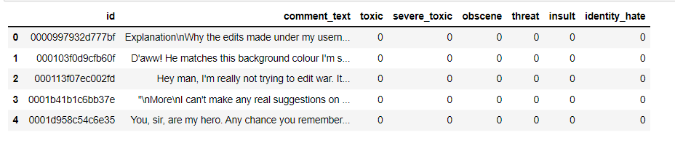
DATASET DETAILS

Slide 4
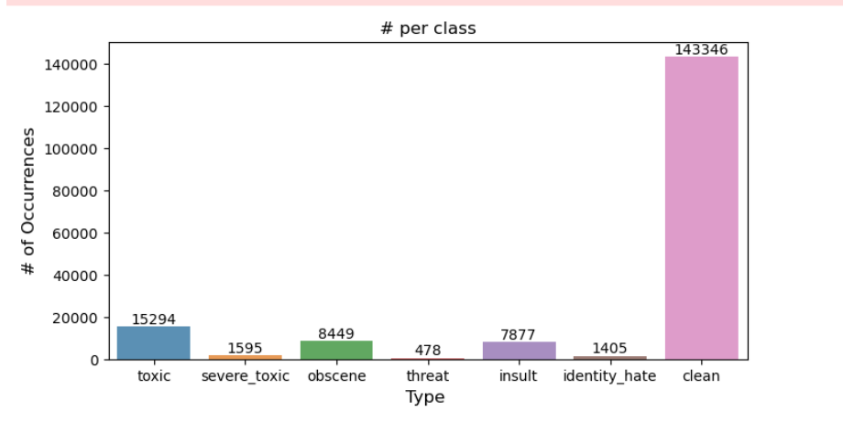
EDA AND VISULIZATION
the dataset comprises a total of 159,571 comments, with distinct categories of toxicity identified. notably, there are 15,294 comments labeled as "toxic," 1,595 labeled as "severe toxic," 8,449 labeled as "obscene," 478 labeled as "threat," 7,877 labeled as "insult," and 1,405 labeled as "identity hate.

Slide 5
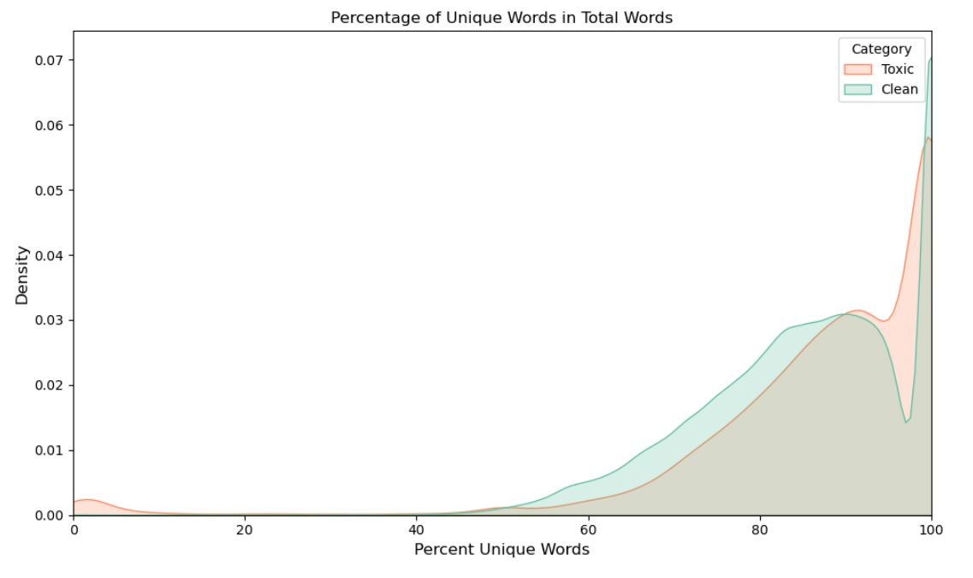
KDE PLOT OF UNIQUE WORDS
YOUR PARAGRAPH TEXT
The kde distribution plot highlights that clean comments tend to exhibit a higher percentage of unique words, reflecting a diverse and varied vocabulary. in contrast, toxic comments often display a broader spread and lower concentration of unique words, potentially indicating repetitive language patterns associated with toxicity.

Slide 6
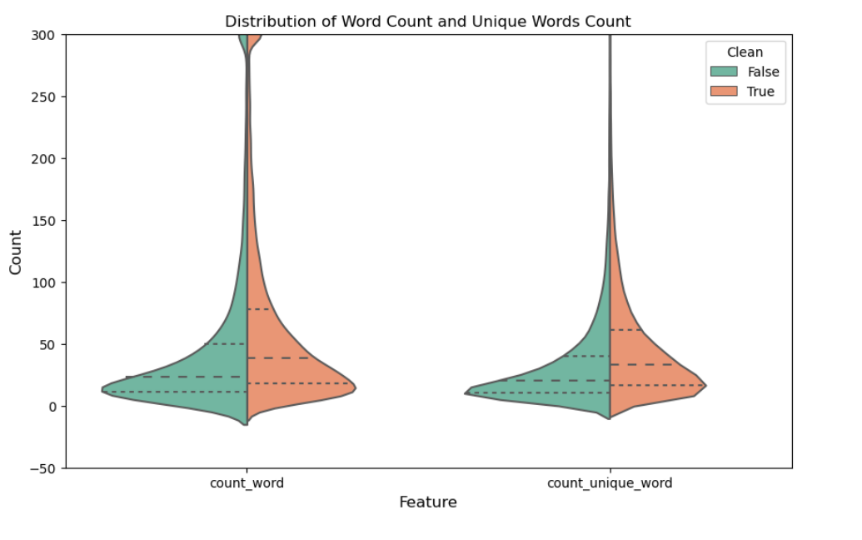
VIOLIN PLOT OF WORDS AND LETTERS
The violin plot facilitates a concise comparison of word count and unique word count distribution shapes and central tendencies between 'clean' and 'non-clean' categories
.

Slide 7
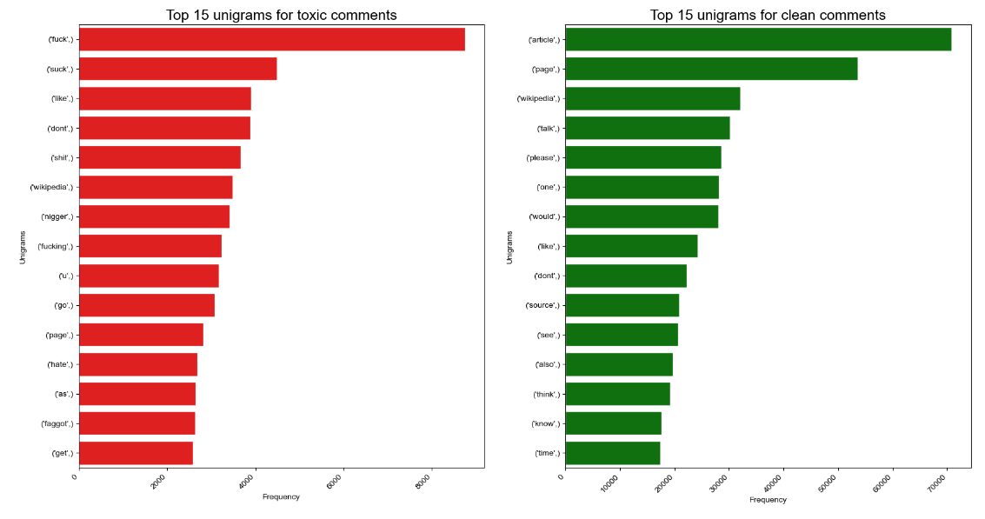
UNIGRAMS

Slide 8
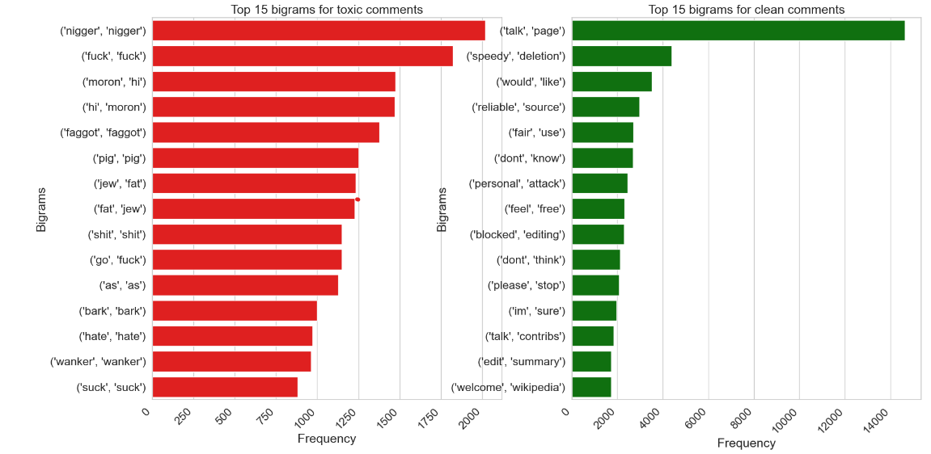
BIGRAMS

Slide 9
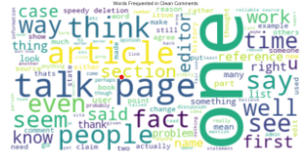
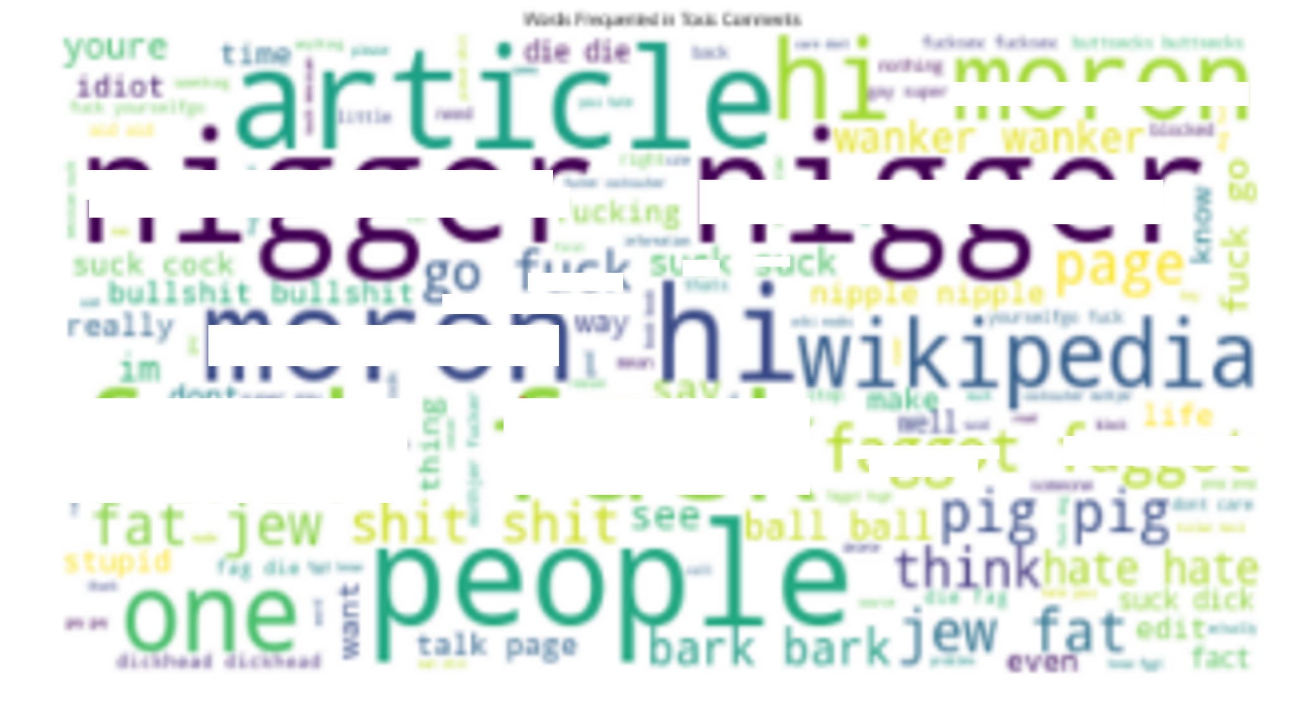
WORDCLOUD
WORDS FREQUENTED IN CLEAN COMMENTS
WORDS FREQUENTED IN TOXIC COMMENTS

Slide 10
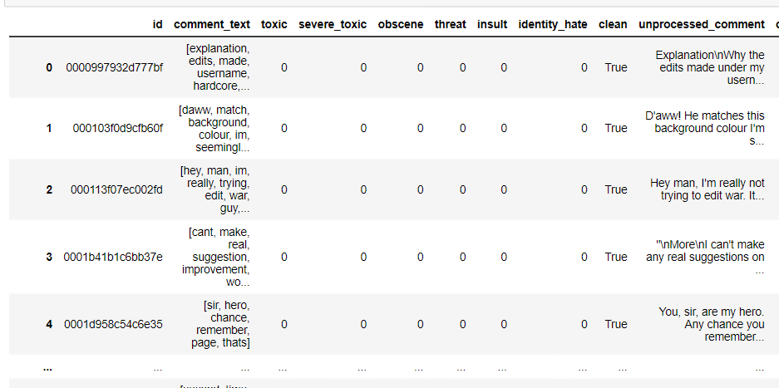
DATA PREPROCESSING
Missing values: . we have 0 null values in our dataset
Text pre-processing: the text has been tokenized, breaking its content into words, and then made uniform by converting everything to lowercase. after that, stopwords and punctuation have been eliminated, and the words have been lemmatized for simplification.

Slide 11
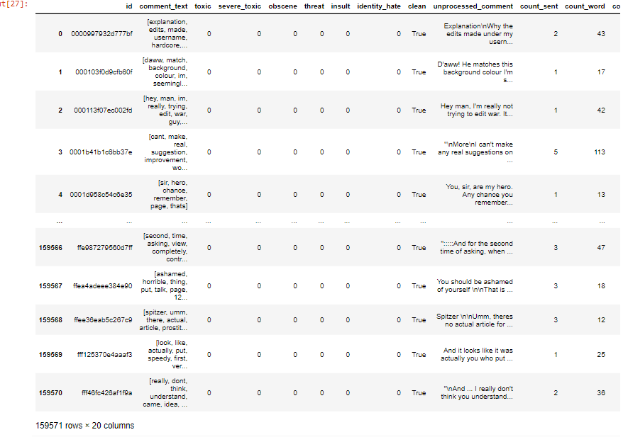
FEATURE ENGINEERING
In the process of feature engineering, the comment text column underwent analysis, yielding counts for words, unique words, characters (including punctuation), and punctuation occurrences. uppercase words, title case words, and frequent stop words were also tallied, enhancing insights for each entry.

Slide 12
VECTORIZATION
A tf-idf (term frequency-inverse document frequency) vectorization technique is applied to the 'unprocessed_comment' column of the dataset, creating a matrix that represents the textual content's importance in relation to the entire corpus. The tfidfvectorizer is configured to limit the number of features to a maximum of 500, helping manage the dimensionality of the data while capturing the most significant terms.
The resulting tf-idf matrix, named 'comment_matrix,' is transformed into a dataframe called 'comment_df.' this dataframe contains numerical representations of the text data, with columns corresponding to the extracted features.

Slide 13
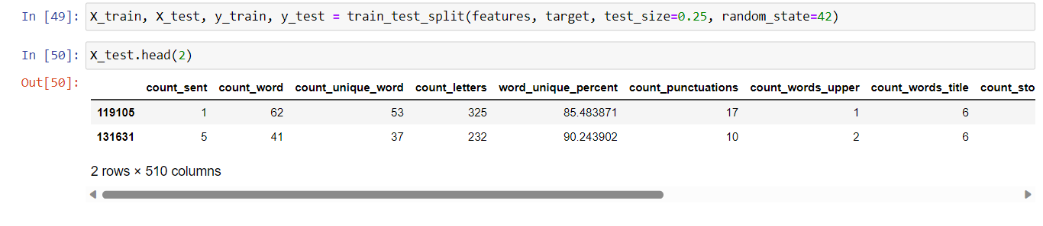
MODELLING
SPLITTING THE DATASET

Slide 14
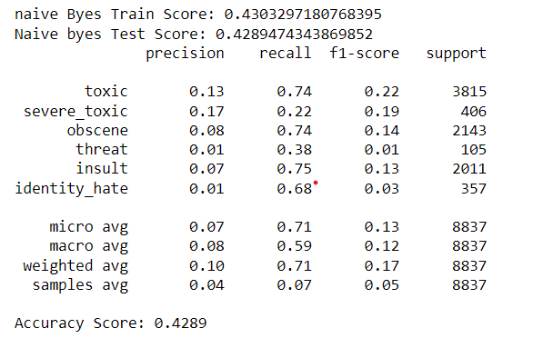
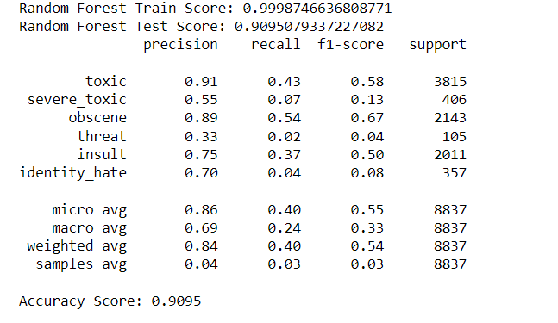
MODELLING
NAIVE BAYES
RANDOM FOREST CLASSIFIER

Slide 15
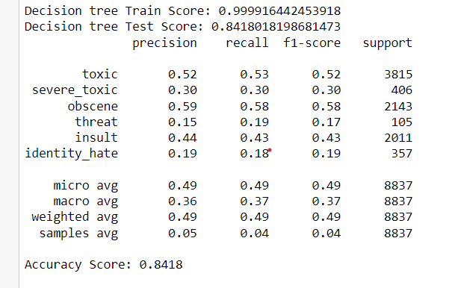
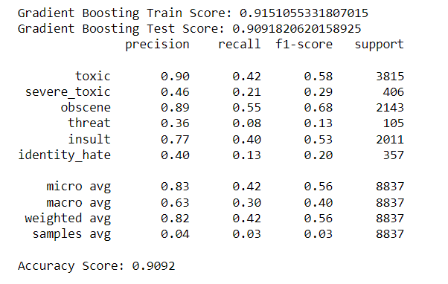
MODELLING
DECISION TREE
GRADIENT BOOST

Slide 16
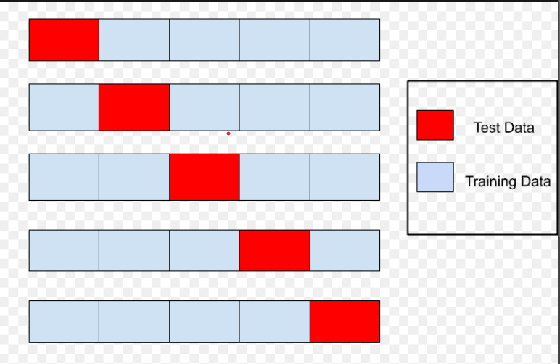
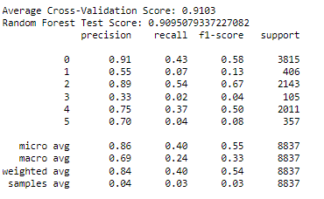
K-FOLD VALIDATION
The classification model's evaluation revealed strengths in precision for specific classes, yet challenges in recall, leading to varied f1-scores across classes.
Classes toxic, obsene, and insult demonstrated favorable balance between precision and recall, while other classes showed discrepancies. Overall, the model displayed promising micro average metrics, suggesting potential for enhancement through targeted adjustments.

Slide 17
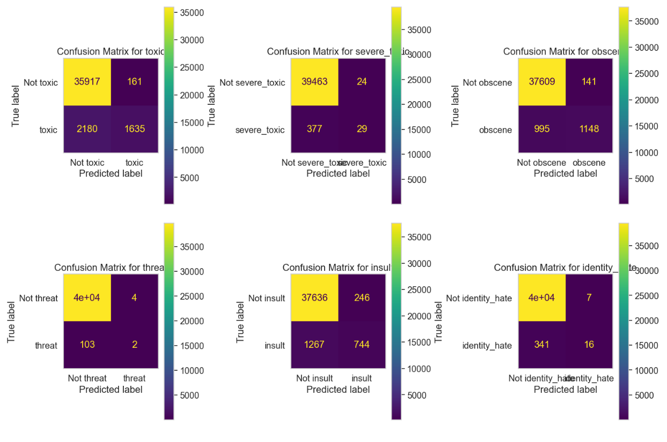
CONFUSION MATRIX
The Random Forest model showcases an impressive training score of 0.9999, indicating a robust alignment with the training data. Meanwhile, it retains a significant test score of 0.9095, underscoring its capacity to effectively extrapolate to new and unseen data.
RANDOM FOREST

Slide 18
CONCLUSION
In this project we analyzed the dataset, starting with eda and visualizations to understand the dataset's structure. preprocessing efforts were substantial due to prominent textual data, involving tasks like tokenization, lemmatization, and tf-idf vectorization. label encoding enabled the transformation of categorical variables into numerical form for ml compatibility.
Addressing class imbalance, we adopted robust k-fold cross-validation, ensuring thorough evaluation. classification models underwent meticulous training and evaluation, revealing potential for improvement, particularly in handling text complexities. notably, the random forest classifier benefited from k-fold cross-validation, improving its metrics.
This process underscores data science's multifaceted nature, especially with unstructured text. progress highlights iteration's importance, while future refinements may involve hyperparameter optimization, advanced text representation techniques, and potentially delving into deep learning for enhanced predictions.

Slide 19
FUTURE WORK
We can use this process on live social media to distinguish the comments and we can extend the process using hyperparameter tuning and also include neural networks and use different techniques for vectorization.

Slide 20
REFERENCES
Toxic comment classification challenge | kaggle. (N.D.). Https://www.Kaggle.Com/competitions/jigsaw-toxic-comment-classification-challenge
Towards Data Science. (n.d.). Text Preprocessing in Natural Language Processing using Python. https://towardsdatascience.com/text-preprocessing-in-natural-language-processing-using-python-6113ff5decd8
3.1. Cross-validation: evaluating estimator performance. (n.d.). Scikit-learn. https://scikit-learn.org/stable/modules/cross_validation.html
Deepanshi. (2023). Text Preprocessing in NLP with Python Codes. Analytics Vidhya. https://www.analyticsvidhya.com/blog/2021/06/text-preprocessing-in-nlp-with-python-codes/

Slide 21
THANK YOU

